Slide 1

Rationale
Introduction to Windows Store App Development Using HTML5 and JavaScript
Computer science is a field of study that deals with solving a variety of problems by using computers.
  To solve a given problem by using computers, you need to design an algorithm for it.
Multiple algorithms can be designed to solve a particular problem.
An algorithm that provides the maximum efficiency should be used for solving the problem.
  The efficiency of an algorithm can be improved by using an appropriate data structure.
Data structures help in creating programs that are simple, reusable, and easy to maintain.
This module will enable a learner to select and implement an appropriate data structure and algorithm to solve a given programming problem.

Slide 2
Objectives
  In this session, you will learn to:
  Add the UI elements to an app
Notes:
2

Slide 3

Selection Controls (Contd.)
  A slider control:
  Allows users to select a value from a continuous range of values.
  The following code snippet adds a slider control:
      <div>Adjust Brightness:</div>
      <input type="range" max="100" min="0" value="20"/>
  Output:
Notes:
3

Slide 4

Selection Controls (Contd.)
  A time picker control:
  Allow the users to select a time instance.
  Displays three drop-down list controls for representing hour, minute, and AM/PM.
  The following code snippet adds a time picker control:
      <div>Select time:</div>
      <div data-win-control="WinJS.UI.TimePicker"
      data-win-options= "{minuteIncrement: 10, clock:'12HourClock', current:'11:20'}"></div>
  Output:
Notes:
4

Slide 5

Selection Controls (Contd.)
  A toggle switch control:
  Is a WinJS control that represents a switch-like button, which can be toggled between two states.
  Can be used to create a selection control, which will have only two options, such as Yes/No, On/Off, or True/False.
  The following code snippet adds a toggle switch control:
      <div data-win-control="WinJS.UI.ToggleSwitch" data-win-options="{ title : 'Tasks:', labelOff:'Not Completed', labelOn:'Completed', checked:'checked'}" ></div>
  Output:
Notes:
5

Slide 6


Just a Minute
  Which one of the following properties of the toggle switch control is used to get or set a value that specifies whether the control is in the on state or in the off state?
  1. title
  2. labelOn
  3. labelOff
  4. checked

Slide 7
Just a Minute (Contd.)
  Solution:
  4. checked

Slide 8
Media Controls
  You can use the audio and video controls to add media controls in your app.
  An audio control:
  Allows you to add sound or audio content to be played in your app.
  Has the following commonly-used properties:
    autoplay
    currentTime
    controls
    duration
    loop
    muted
    paused
    src
    volume
Notes:
8

Slide 9
Media Controls (Contd.)
  The following code snippet adds an audio control to an app:
        <audio src="music\Katy.mp3" controls loop="loop">
        </audio>
  Output:
Notes:
9
Explain the video control on similar lines.

Slide 10
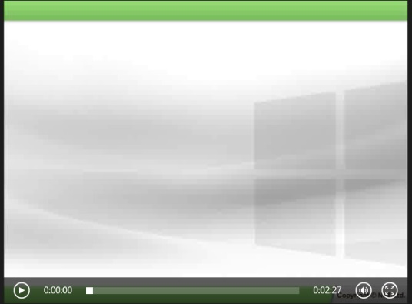
Media Controls (Contd.)
  A video control:
  Allows you to add video content to be played in your app.
  Has the following commonly-used properties:
    poster
    height
    width
  The following code snippet adds a video control to an app:
        <video src="video\Windows Store Apps.wmv" controls></video>
  Output:
Notes:
10

Slide 11
Progress Controls
  You can use progress controls in your app to represent the progress of an operation that takes more than two seconds to complete.
  The following progress controls can be used in an app:
  Progress bar
  Progress ring

Slide 12

Progress Controls (Contd.)
  A progress bar control:
  Indicates the progress of an operation by displaying a bar.
  Shows either determinate or indeterminate progress.
  Has the following commonly-used properties:
    max
    value
  The following code snippet adds a determinate progress bar to an app:
        <div>Duration:</div>
        <progress value="15" max="50"/>
  Output:

Slide 13

Progress Controls (Contd.)
  The following code snippet adds an indeterminate progress bar to an app:
        <progress></progress>
  Output:

Slide 14

Progress Controls (Contd.)
  A progress ring control:
  Indicates the indeterminate progress of an operation by displaying a ring.
  The following code snippet adds a progress ring control to an app:
        <progress class="win-ring" style="width: 50px; height: 50px" />
  Output:

Slide 15

Rating Control
  A rating control:
  Allows a user to evaluate or assess something by clicking a set of star icons.
  Has the following commonly-used properties:
    averageRating
    enableClear
    maxRating
    userRating
  Can be added to an app by using the following code snippet:
      <div data-win-control="WinJS.UI.Rating"
      data-win-options="{maxRating: 10}"></div>
  Output:

Slide 16
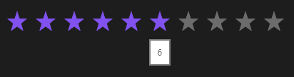


Rating Control (Contd.)
  A tentative rating:
    Highlights the selected stars and displays a tooltip over it.
  A user rating:
    Shows the marked stars.
  An average rating:
    Shows the average of the total rating.

Slide 17
Just a Minute
  Which one of the following ratings is displayed when a user hovers the mouse pointer over the rating control?
  1. Average rating
  2. Tentative rating
  3. User rating

Slide 18
Just a Minute (Contd.)
  Solution:
  2. Tentative rating

Slide 19
Summary
  In this session, you learned that:
  A slider control allows users to select a value from a continuous range of values.
  A time picker control allow the users to select a time instance.
  A toggle switch control is a WinJS control that represents a switch-like button, which can be toggled between two states.
  You can use the audio and video controls to add media controls in your app.
  You can use progress controls in your app to represent the progress of an operation that takes more than two seconds to complete.
  A rating control allows a user to evaluate or assess something by clicking a set of star icons.
Notes:
19

Slide 20

Q&A

